Slide 1

Angular School
Lesson 8. Change Detection

Slide 2

LESSON PLAN
What is change detection
Who is notifies angular about changes
Zone.js
How to change detection performed
Performance
Smart change detection
OnPush + Immutable + Observable

Slide 3
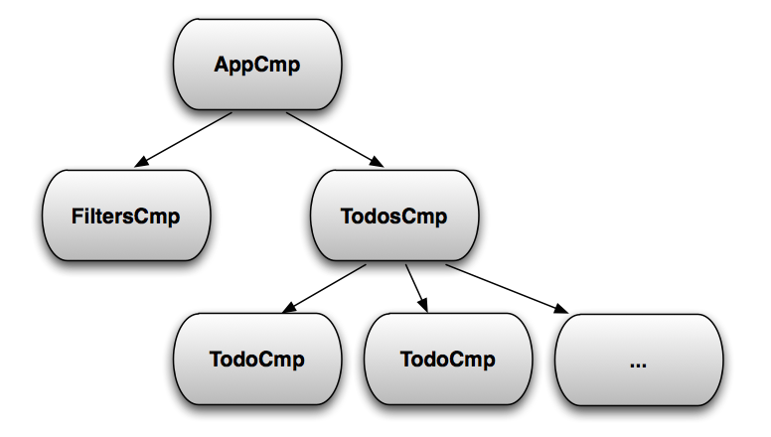
HIGH-LEVEL OVERVIEW

Slide 4
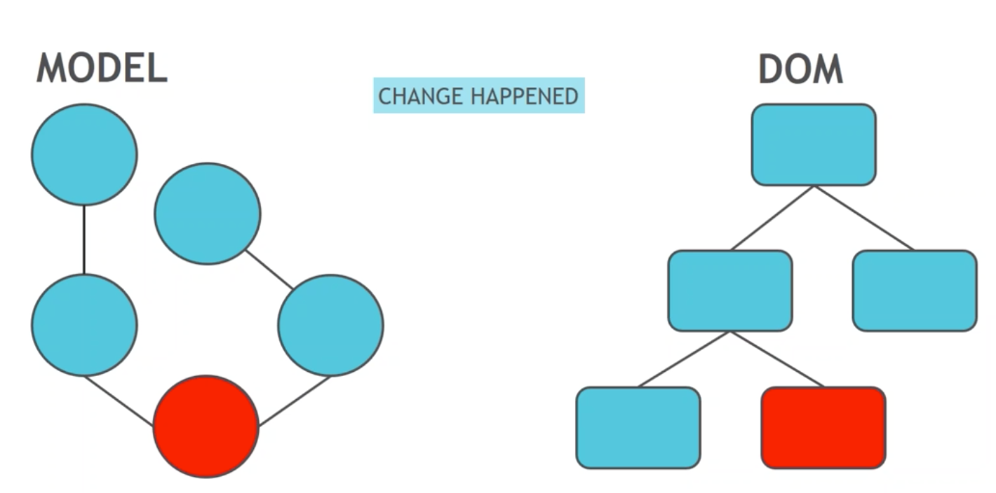
CHANGE DETECTION

Slide 5
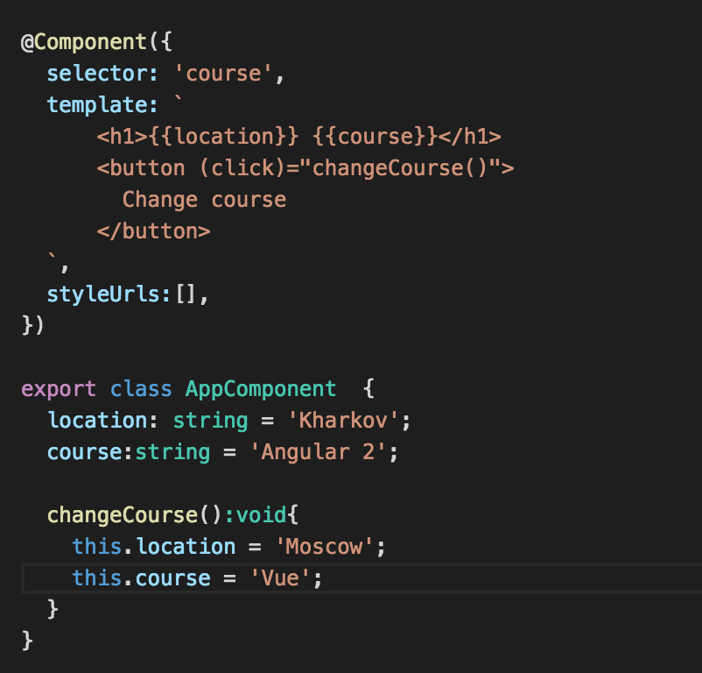
CHANGE DETECTION

Slide 6
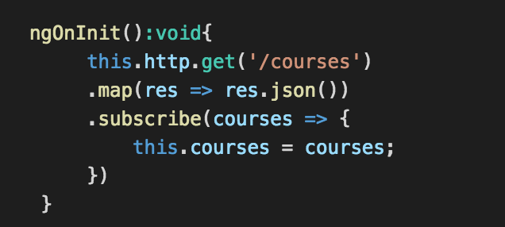
CHANGE DETECTION

Slide 7
CHANGE DETECTION
Things that cause change :
All browser events - click, mouseover, keyup, etc
XHR - Fetching data from the server
Timers - setTimeout, setInterval

Slide 8
CHANGE DETECTION
Who notifies angular

Slide 9
CHANGE DETECTION
Overriding browser default
mechanisms

Slide 10
CHANGE DETECTION

Slide 11
CHANGE DETECTION
How does this low-level
runtime patching works

Slide 12
CHANGE DETECTION
Zones

Slide 13
CHANGE DETECTION
Let’s refresh our JavaScript
knowledge first

Slide 14
CHANGE DETECTION

Slide 15
CHANGE DETECTION
How can Zones help us?
Zones can perform an operation each
time code enters or exits task!

Slide 16
CHANGE DETECTION

Slide 17
CHANGE DETECTION
onZoneCreated - Runs when zone is forked
beforeTask - Runs before a function called with zone.run is executed
afterTask - Runs after a function in the zone runs
onError - Runs when a function passed to zone.run will throw
Monkey-patched Hooks
Zone.setInterval()
Zone.alert()
Zone.prompt()
Zone.requestAnimationFrame()
Zone.addEventListener()
Zone.removeEventListener()

Slide 18
CHANGE DETECTION

Slide 19
CHANGE DETECTION
Angular 4 has its own zone
NgZone
NgZone - forked zone with additional API based on observables

Slide 20
CHANGE DETECTION
NgZone additional APIs
onUnstable()
onMicrotaskEmpty()
onStable()
isStable()
runOutsideAngular()

Slide 21
CHANGE DETECTION

Slide 22
CHANGE DETECTION
Angular notifies itself about
changes!

Slide 23
CHANGE DETECTION
How to change detection is
performed?

Slide 24
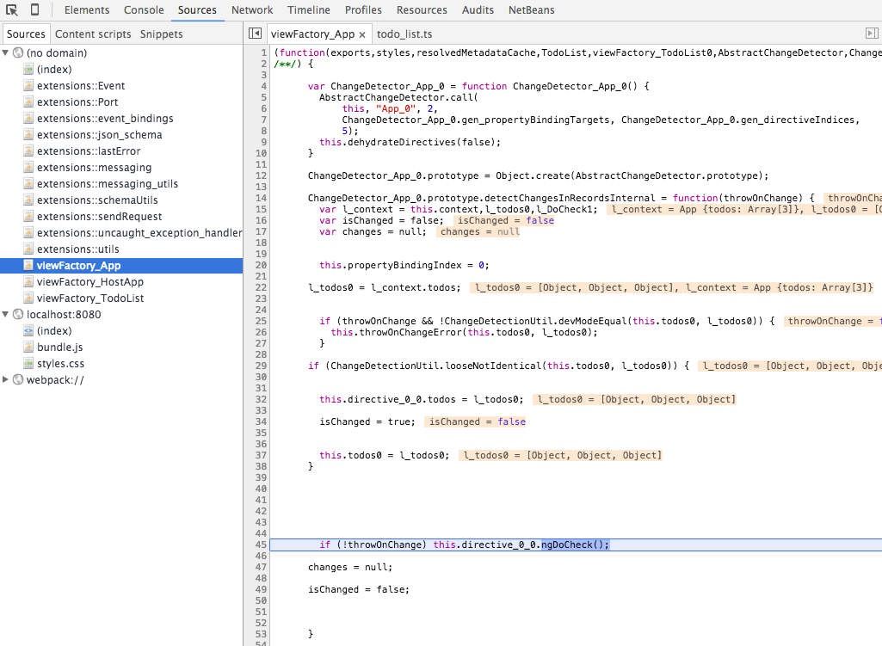
CHANGE DETECTION

Slide 25
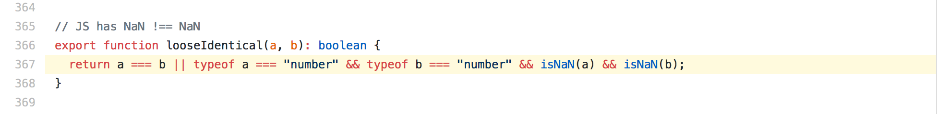
CHANGE DETECTION

Slide 26
CHANGE DETECTION
Summarise
Change detection tree is a directed graph
Way more predictable
Gets stable after single pass
Generate VM friendly code for better performance

Slide 27
SMART CHANGE DETECTION

Slide 28
SMART CHANGE DETECTION
Angular can skip entire Change
Detection subtree when inputs
properties does not change

Slide 29
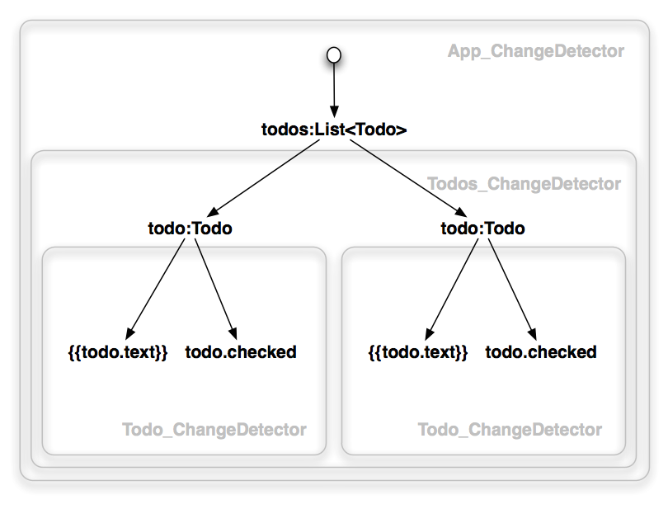
EACH COMPONENT HAS ITS
OWN CHANGE DETECTOR

Slide 30
CHANGE DETECTORS
Every component gets a change detector responsible for
checking the bindings defined in its template.

Slide 31
CHANGE DETECTION
Angular 4 change detection
system can go through hundreds
of thousands of simple checks

Slide 32
CHANGE DETECTION
Angular has to be conservative and run all
the checks every single time because the
JavaScript language does not give us object
mutation guarantees. But we may know that
certain properties hold if we, for example,
use immutable or observable objects.

Slide 33
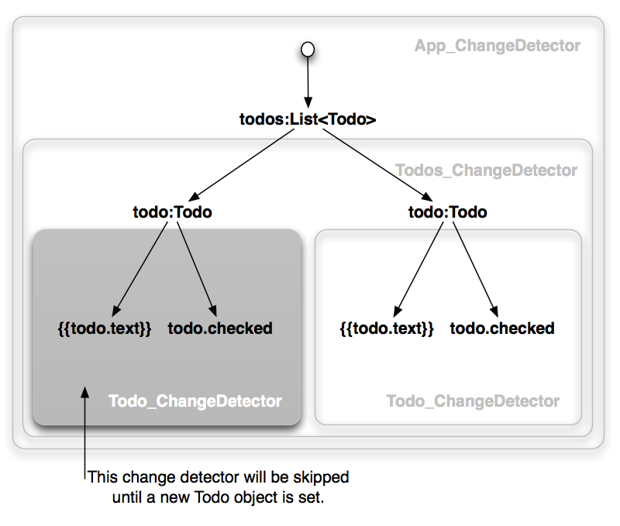
SKIPPED CHANGE DETECTION

Slide 34
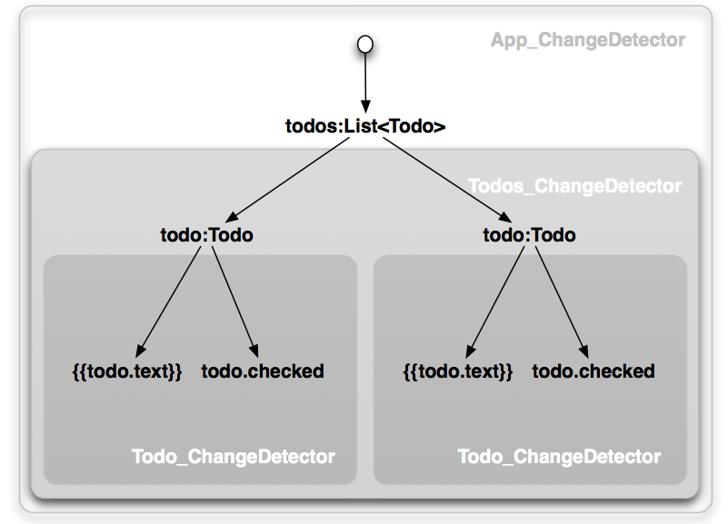
HOW TO DISABLE CHANGE
DETECTION

Slide 35
HOW TO DISABLE CHANGE
DETECTION

Slide 36
BUT!
It is worth noting that a component can still have private mutable state

Slide 37
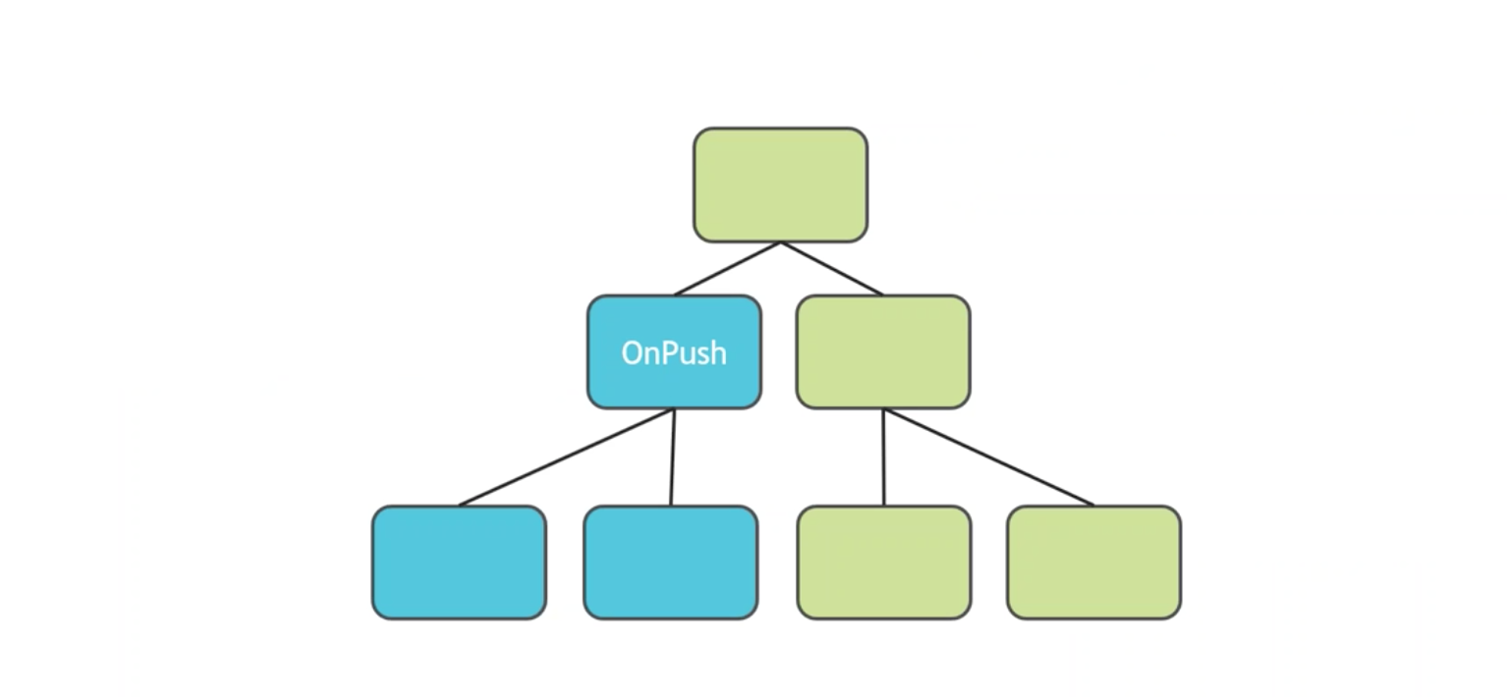
SMART CHANGE DETECTIONS

Slide 38
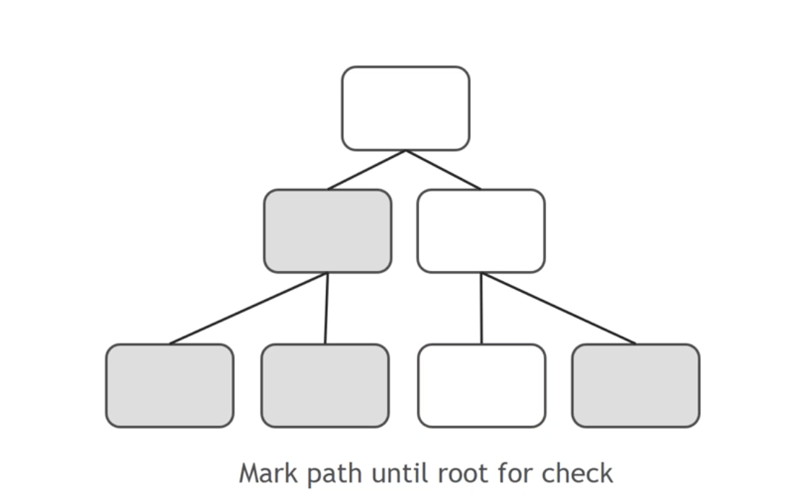
SMART CHANGE DETECTIONS

Slide 39
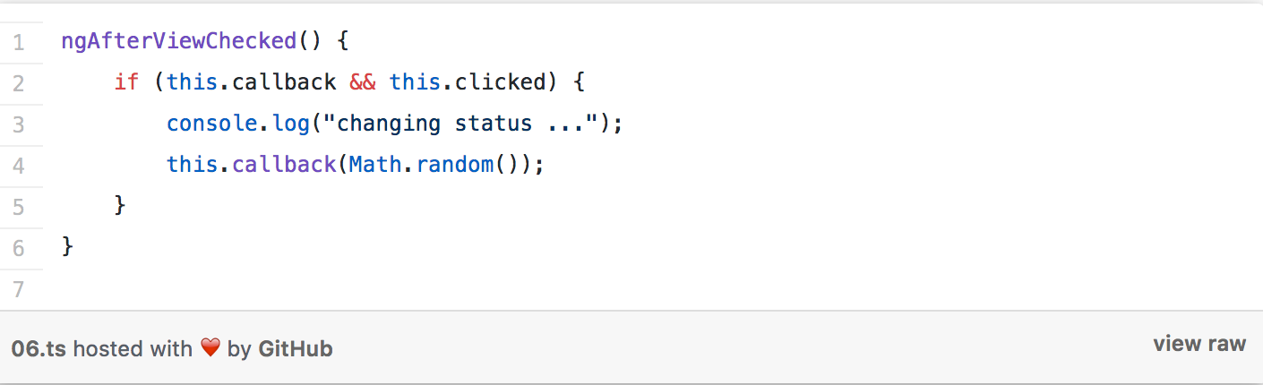
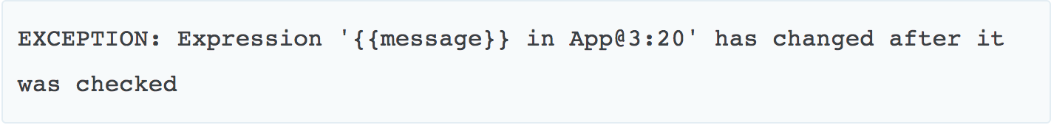
HOW TO TRIGGER A CHANGE
DETECTION LOOP IN
ANGULAR?

Slide 40
SMART CHANGE DETECTIONS -
USE IMMUTABLE OBJECTS
Implements immutability
Vanila
Seamless immutable
Immutable

Slide 41
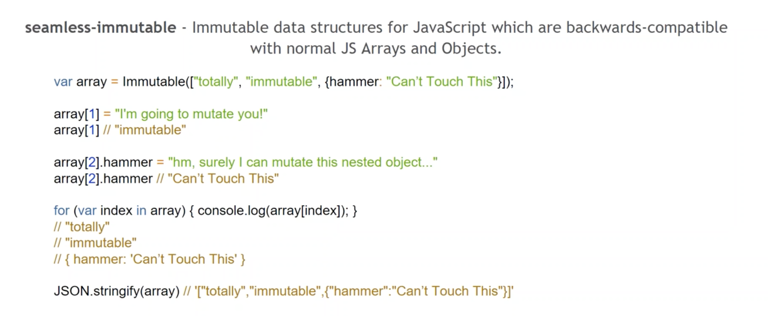
SMART CHANGE DETECTIONS

Slide 42
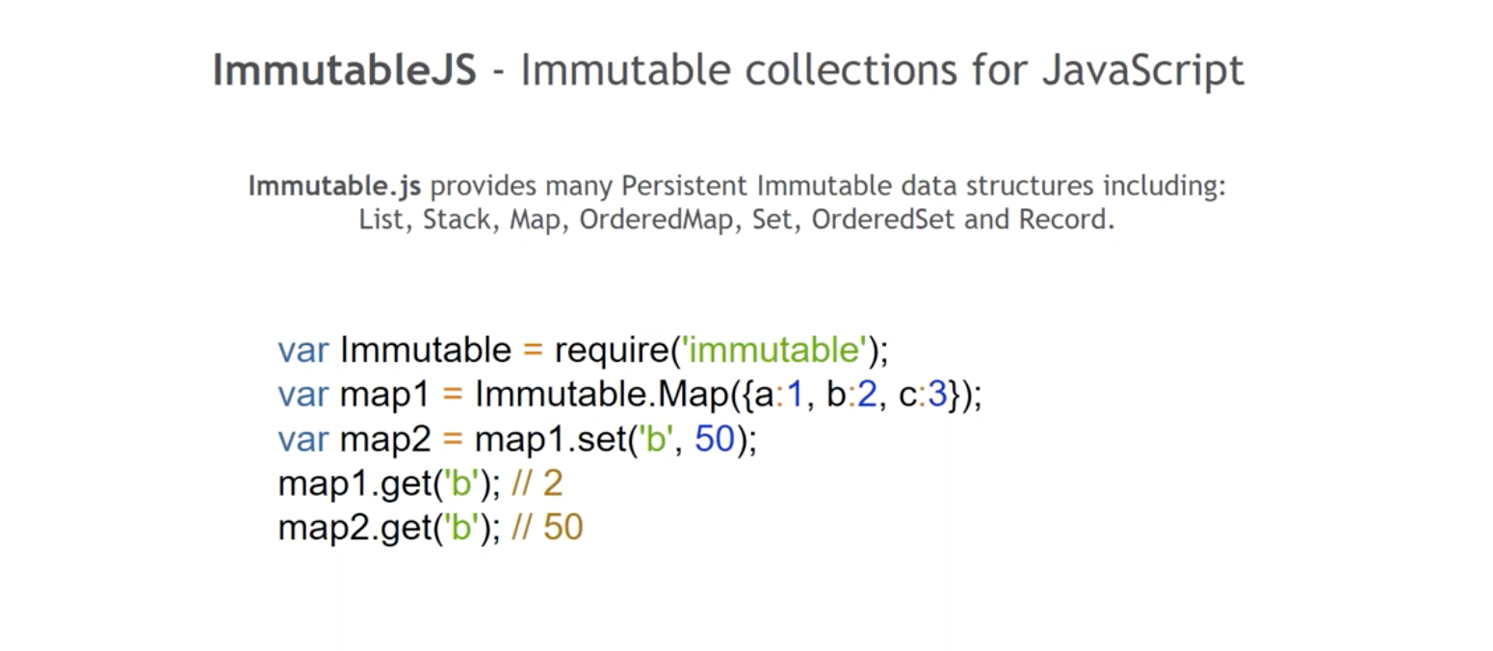
SMART CHANGE DETECTIONS

Slide 43
SMART CHANGE DETECTIONS

Slide 44
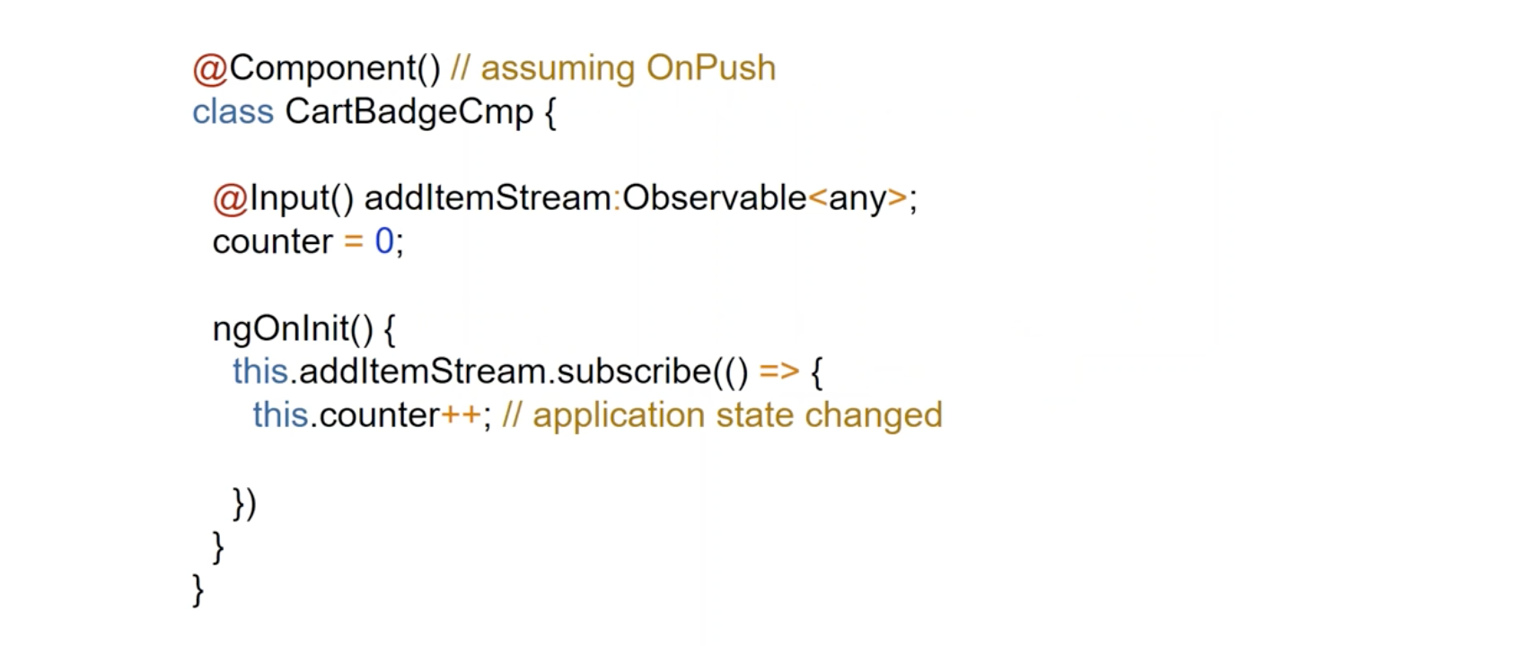
SMART CHANGE DETECTIONS

Slide 45
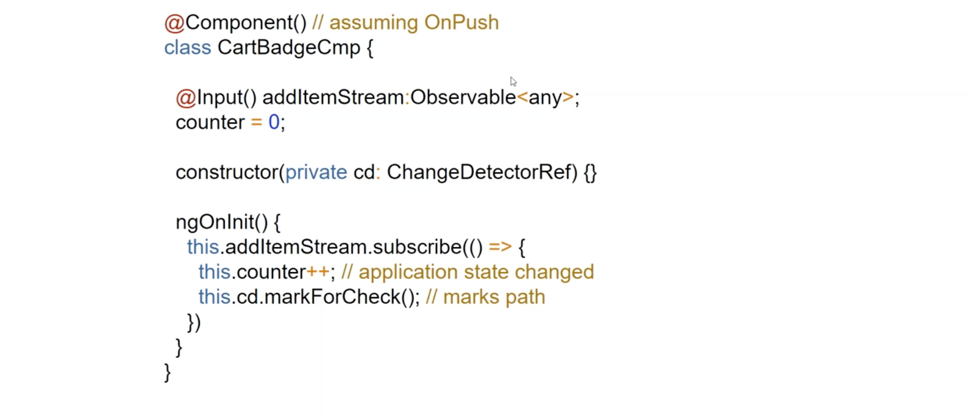
SMART CHANGE DETECTIONS

Slide 46
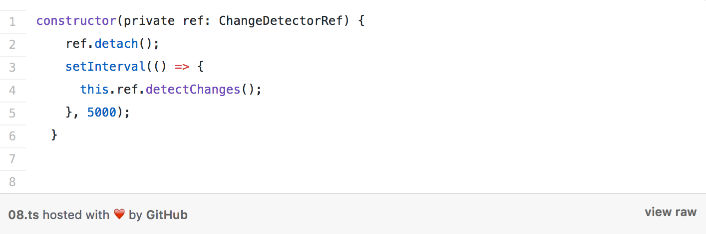
SMART CHANGE DETECTIONS

Slide 47
Angular School
Thanks!

